Slide 1
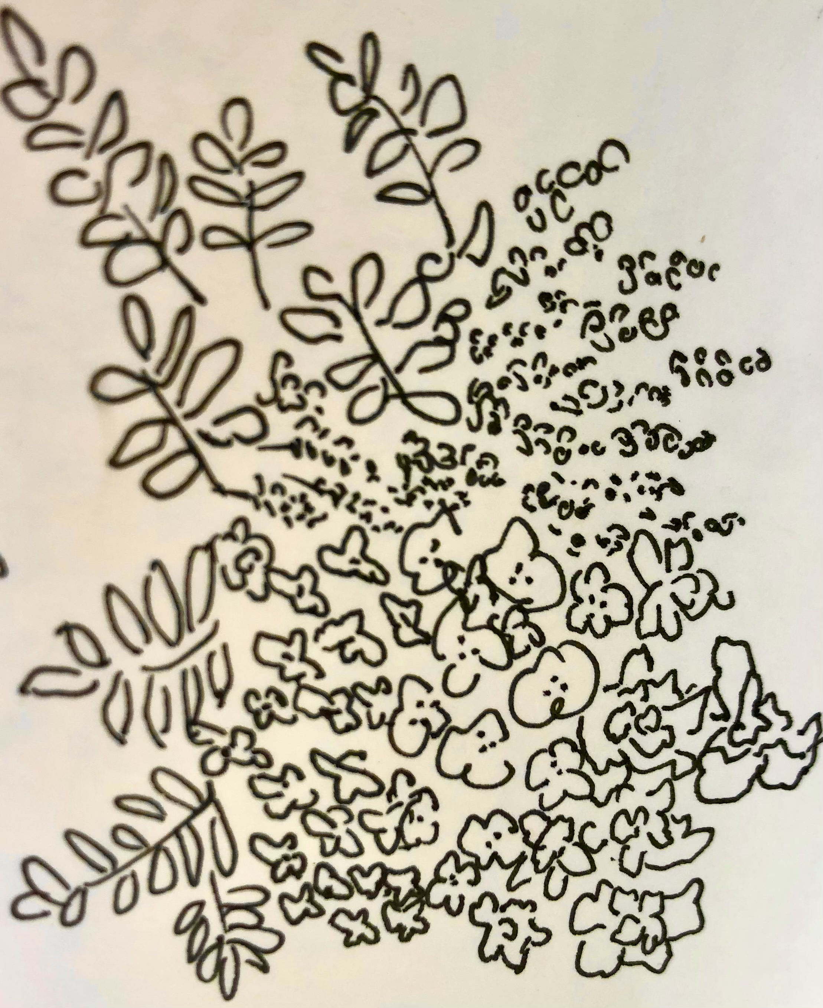
Let’s create a calmer world together in just 15 minutes a day.

Slide 2
Stress tracking is taking off.
Stress detection is insightful—but can be stressful for wearable subscribers.
5 Senses delivers immediate, real and personalized stress relief in 15 minutes.

Slide 3
5 Senses
Plug & Play Stress Relief for Wearable Tech
Founder:
Dr. Katrina Nakamura, Stress scientist
(808) 319-7754
Katrina@Sustainability-Incubator.com
Co-Winner of the Partnership for Freedom
Grand Prize for tech to eliminate modern slavery

Slide 4
5 Senses is a lightweight, secure, web-based and private stress mitigation delivering real and immediate relief to wearable subscribers when needed most—at the point of stress detection. Subscribers instantly access 5 Senses in the same push notification via a time-limited QR code/link. No user data is collected by 5 Senses or from our partners making integration seamless (no SDK, nothing to download).
Multiple languages & custom formats are available (athletic, longevity, menopause, recovery).
Try the longevity spa format at https://talktomeinflowers.com/.

Slide 5
Value for Wearable Tech Subscribers:
Release trapped stresses with empirically-proven techniques. Learn how your body is optimizing energy today. Gain a personalized remedy for a re-set, simply using your senses, and re-energize
-- all within 15 minutes.
---
Value for Wearable Tech Partners:
Innovative scalable value with low cost & risk, higher user engagement, brand loyalty, customer satisfaction from immediate results, time, frequency & effectiveness on your device.

Slide 6
5 Senses alleviates a major pain point:
“I’m really stressed, apparently, and this smartwatch wants me to think about it. It’s always searching for signs of stress. For a week, it buzzed incessantly as we constantly worried.” Fitbit Sense 2 review
Stress antidotes are not yet delivered effectively by wearable tech for at least 4 reasons: the device and bluetooth generate physical stresses that can add to immune dysregulation, users’ health data is commercialized in addiction-seeking applications, techniques for a re-set from stress are not empirically-proven or easy, and advice to “Be Mindful” can leave mentally-overwhelmed subscribers behind in an echo chamber, leading to burn-off from device use.

Slide 7
Packed with empirically-proven techniques and scientific knowledge,
5 Senses delivers an
actively calming experience
and a paradigm-shifting breakthrough in how tech affects our bodies.
Try it today at https://talktomeinflowers.com/.

Slide 8
Licensing Options
Tiered per-use pricing
Monthly or annual pricing
(per 1,000 users)
3. Flat-rate pilot for early-stage partners

Slide 9
Pricing:
Contact 5 Senses at 808 319-7754 or info@sustainability-incubator.com to discuss a trial and the best fit for your firm.
Users | <1000 | 1000-5000 | 5000+
Average price per sale | $10/user/monthly or $7500/subscription for 1000 uses | $9/user/monthly or $35,000/subscription for 5000 uses | $8/user/monthly or $65,000/subscription for 10,000 uses

Slide 10
A better life is accessible to everyone by engaging
5 Senses
Aloha and see you soon at https://talktomeinflowers.com/

