Slide 1
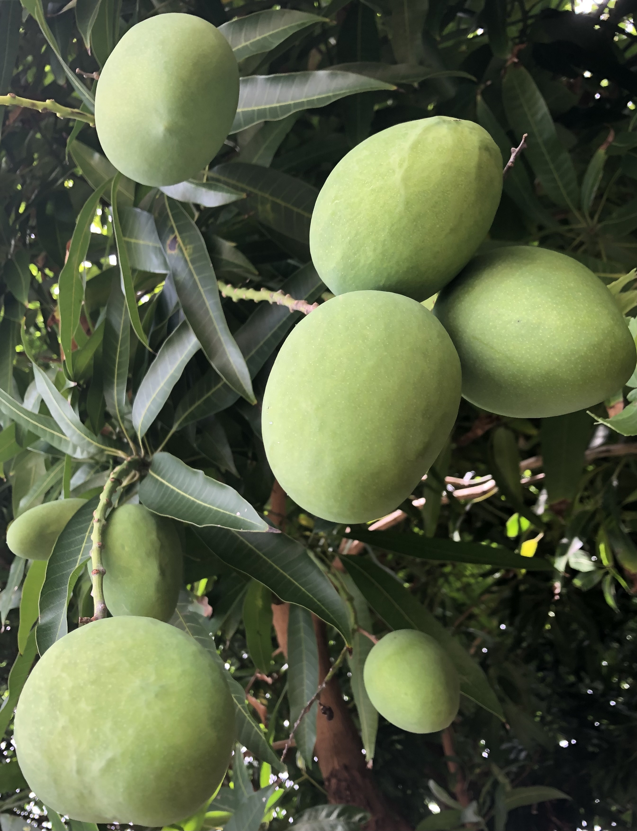
HOW AM I TODAY?
Mind Body Review
Talk to Me in Flowers

Slide 2
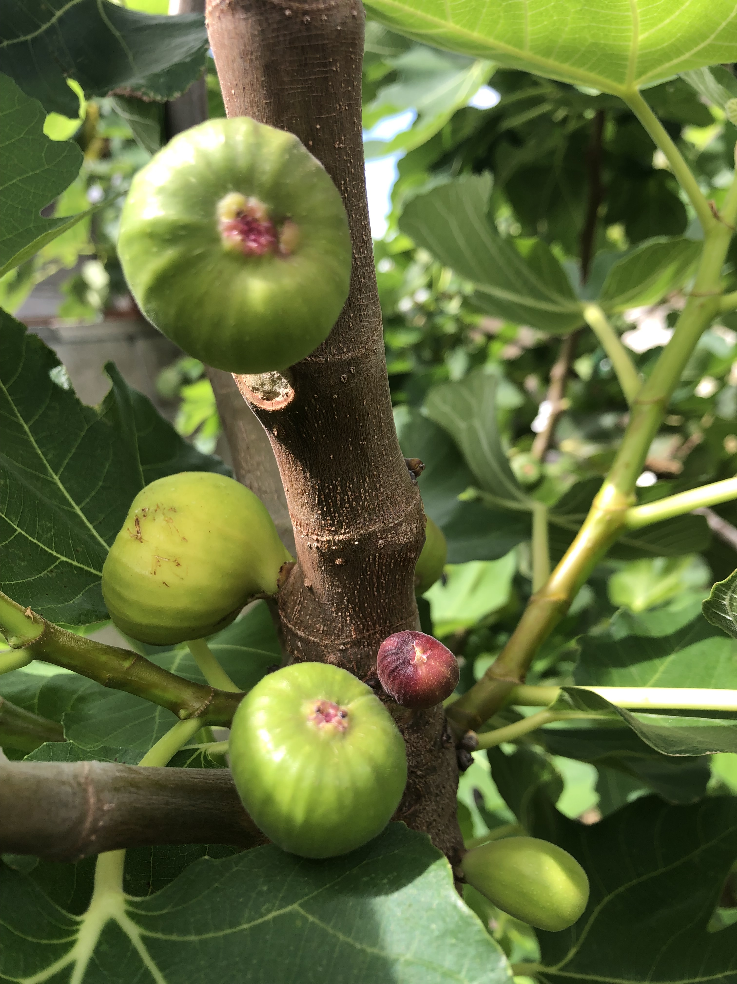
Biological Age & Sex: ___ ___
This past week, how effortless were your:
1. Sleep
2. Digestion
3. Daily
Relationships
Easy
Mild challenges
Restless
Smooth
Mild challenges
Stuck
Easy
Mild challenges
Tougher than usual
Talk to Me in Flowers

Slide 3
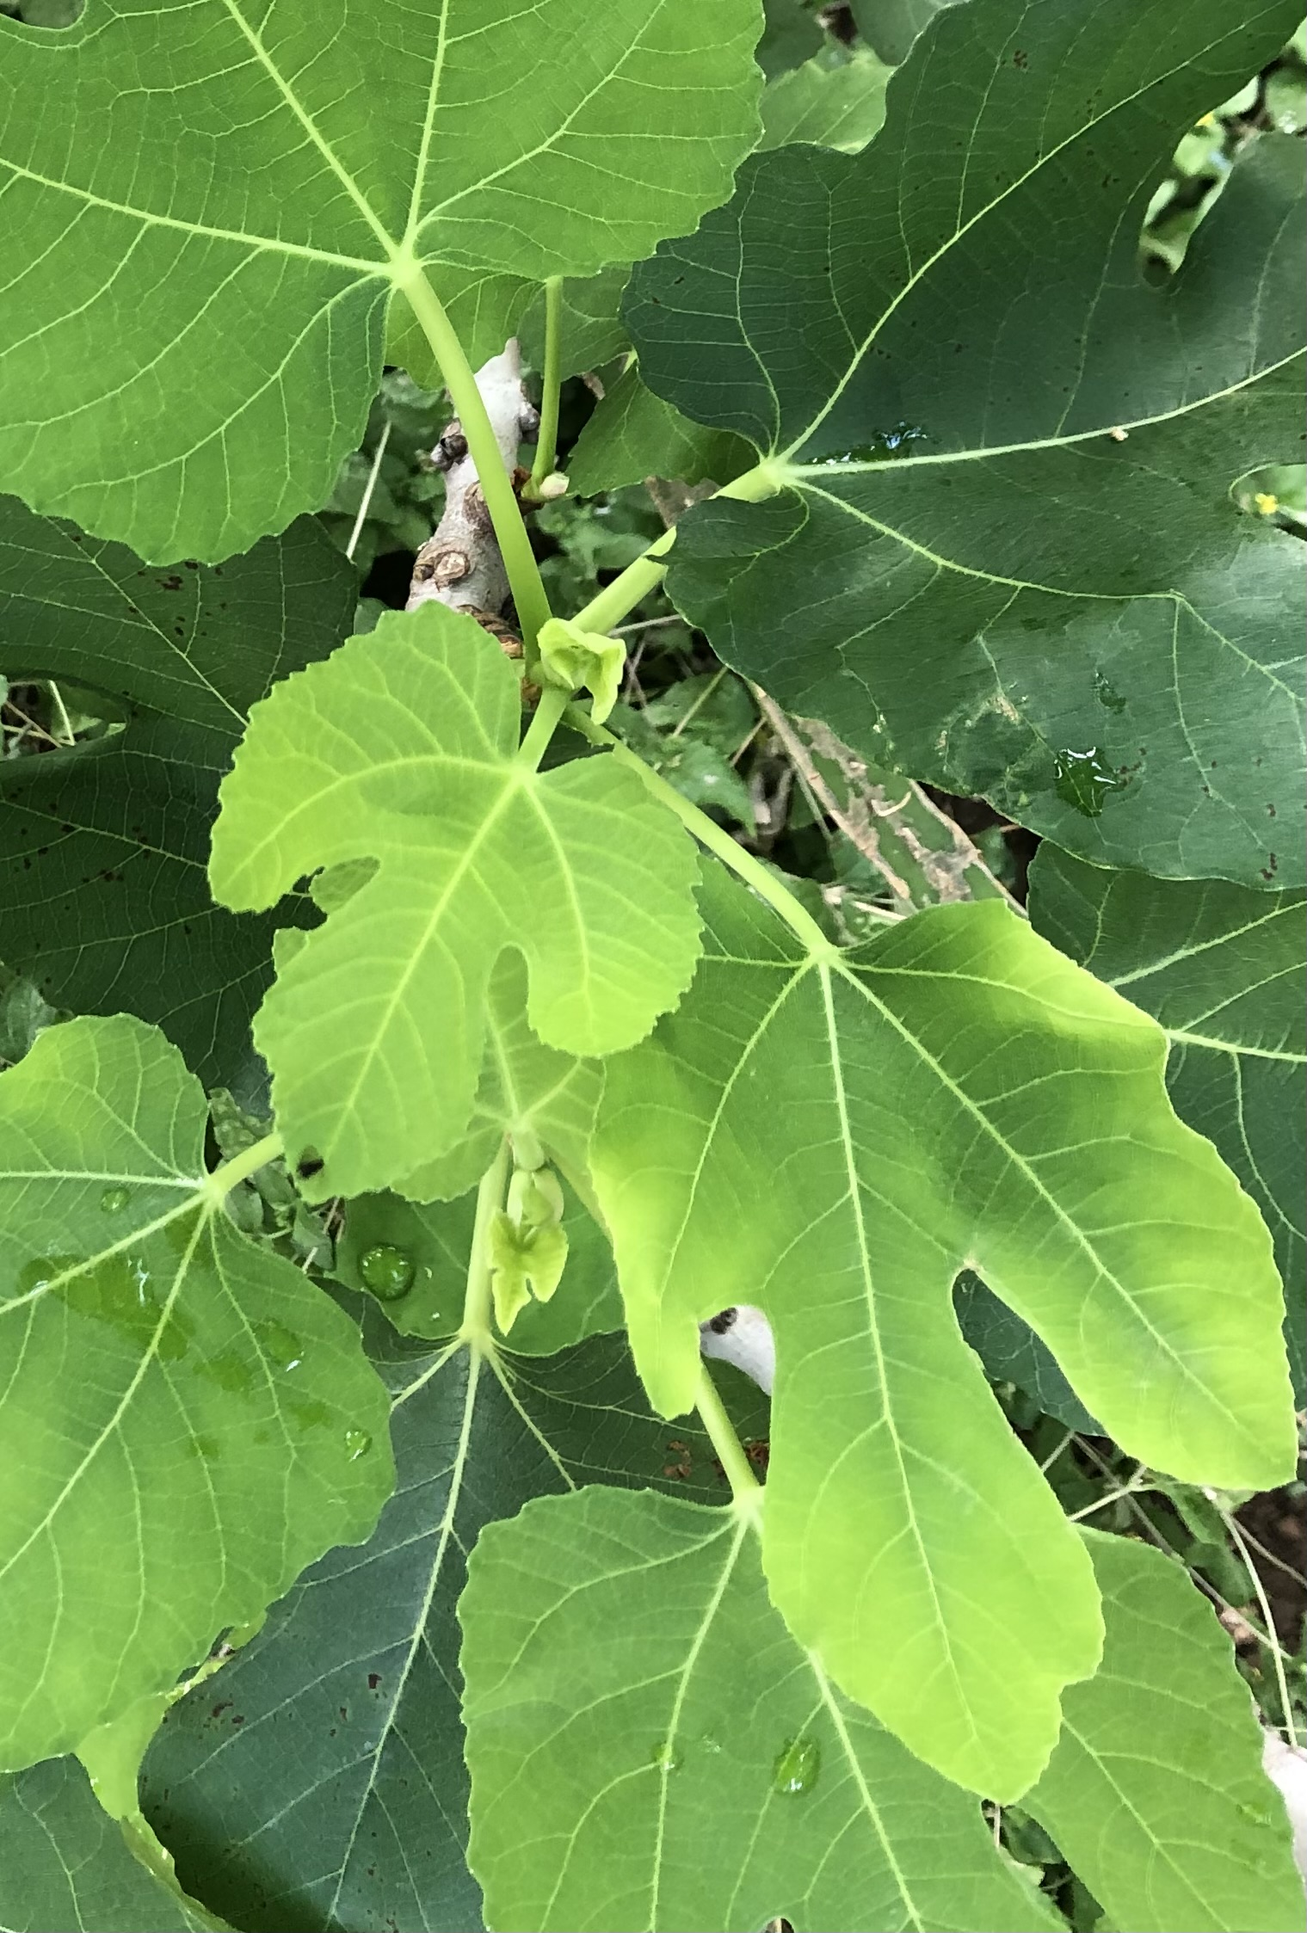
4. Your Pulse: ___bpm
Feels strong right now
Seems normal
Feels a little weak right now
5. The top of my abdomen feels:
6. Right now my eyes, tongue or complexion look:
(Pick one)
7. My body feels:
Soft when pressed
Stiff when pressed
Pale or dull
Flushed red or dry
Bright & hydrated
Dry or parched
Hydrated right now
Heavy or swollen
Feel
Cold
Running hot
Talk to Me in Flowers

Slide 4
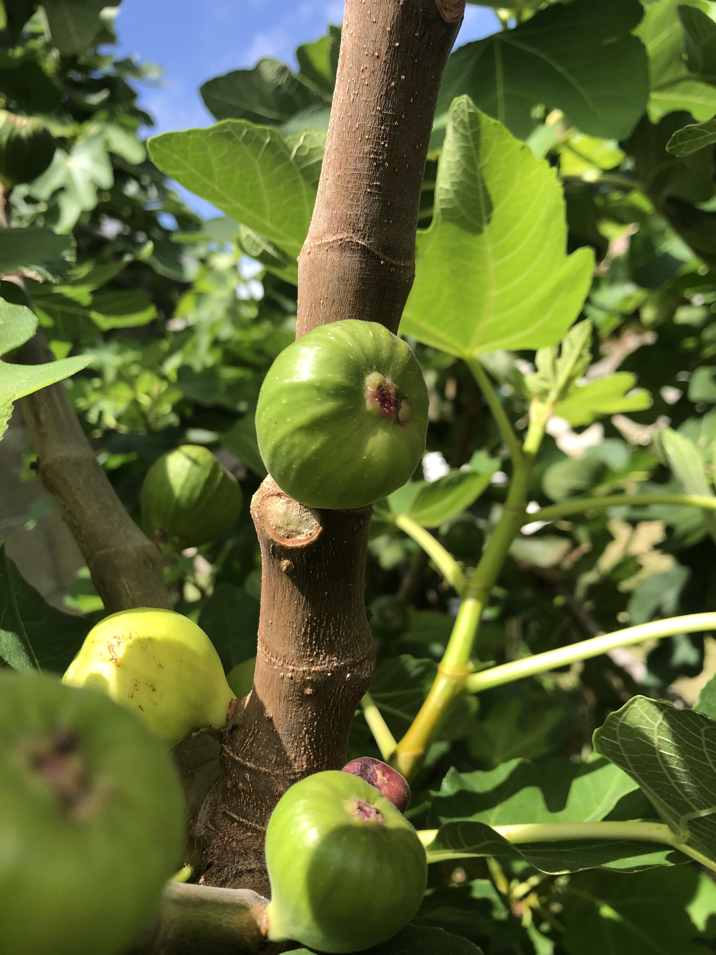
8. Are you currently experiencing a big transition?
Yes
No
Moving, job, new child, family break up, empty nest, life crisis, physical change/lost function (injury recovery, menopause etc.)
9. If this past week included any notable negative experiences, do you still feel any of those emotions in your body?
10. The next few hours will be wonderful. Recall a pleasurable experience and relive it for 30-60 seconds. What do you feel?
No. I feel calm now
Yes I feel it in my chest
Yes I feel it in my head
Yes I feel it in my gut
Not any more but I feel exhausted
Comfort,Relaxed
Mixed feelings
Still a little stressed
Talk to Me in Flowers

Slide 5
SAMPLE RESULT
Young man, aged 23, athletic and smoker:
Mild challenges with digestion can mean your food energy is low or stuck. When lying down to sleep, try breathing deeply into your abdomen while lightly tracing counterclockwise circles or holding it with your hands. It sounds like heat may also be trapped and moving upward from your abdomen or chest causing heart overstrain and head causing overthinking or irritability (you mentioned a strong pulse with dryness and head symptoms). Try releasing head tension by gently pressing on the sides of your head, between the eyebrows, or along the lower ribs and tops of feet.
Evening activities like taking a short walk outdoors in moonlight, weather permitting, or listening to instrumental music or quiet will help too, as will eating meals without multi-tasking whenever possible. An oil massage on your face before retiring will also help with dryness and clear some inflammation.
Talk to Me in Flowers

Slide 6
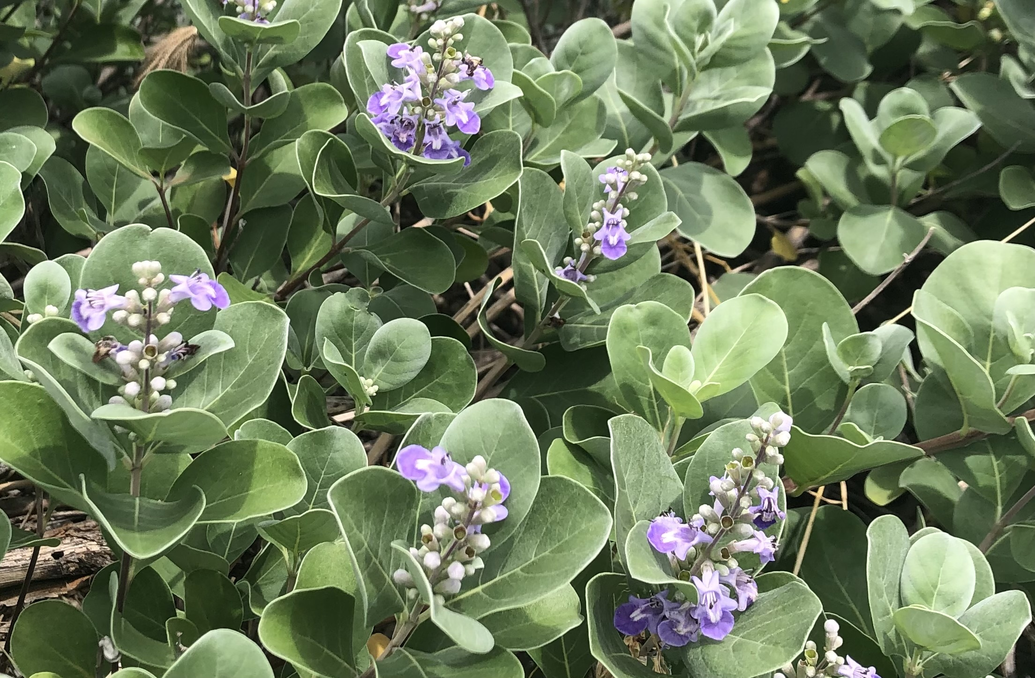
THE POWER of 5 SENSES
Personalized insights are generated from responses to Questions 1-10 and users receive a new and timely view of themselves. The view includes their energy level today, insights into why their body feels like it does, and practical suggestions for alleviating stress right now.
Personal narratives are collected for key insight to mind-body balance in Japanese/Chinese medical traditions and in luxury longevity spas.
5 Senses is not a medical diagnosis. The questions are selected from a Kampo survey prepared by 3 Japanese universities and validated in German, Japanese and English by a German gastroenterology team.
Energy flows easily through a balanced body. That overarching principle is the secret of 5 Senses, which functions like a 5D mirror for users to gain immediate relief and self-awareness by using their five senses to recognize obstructions from navigating the stresses of daily life that could be causing physical imbalances like overheating or a drop in energy levels, or persisting and accelerating aging and disease.
Talk to Me in Flowers

Slide 7
Young adult
Early family & career woman
Early family & career man
Mid-life woman
Mid-life man
6.
7.
8.
9.
10.
1.
2.
3.
4.
Senior
Pale or dull skin, eyes or tongue
Flushed red or dry
Bright & hydrated
Easy sleep
Mild challenges
Restless
Body feels dry or parched
Hydrated right now
Heavy or swollen
Feel
Cold
Running hot
BACK OF HOUSE VIEW
OF THE SCORING KEY
SCORING KEY:
Qi is low or stuck today
Yang today high or stuck
Yin today is low or stuck
Low fluids today
Retaining fluid today
Vital today
Could also indicate:
Smooth digestion
Mild challenges
Stuck
Yes transition
No
Easy relations
Mild challenges
Tougher than usual
No. I feel calm now
Yes I feel emotion in my chest
Yes I feel it in my head
Yes I feel it in my gut
Not any more but I feel exhausted
Belly soft when pressed
Stiff when pressed
5.
Pulse strong right now
Seems normal
Feels a little weak right now
Comfort/relaxed now
Mixed feelings now
Still a little stressed
Talk to Me in Flowers

Slide 8
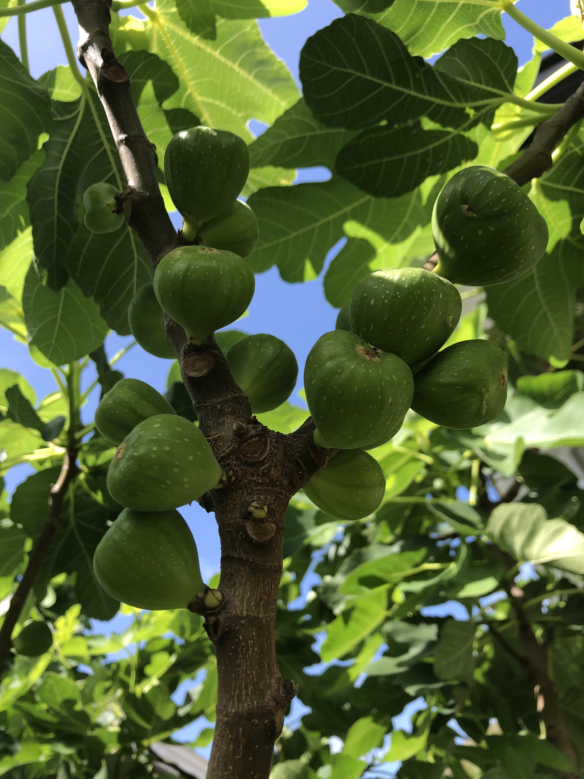
Suggestions 1/3 Users receive a Mind Body Review with Suggestions that are based on the information they provided, like the following:
Age/Sex.
For young adults: offer an herbal tea (cold or hot) and do a stretch combined with slow breathing into the lower abdomen.
New parents: acknowledge their load and offer comforts like herbal tea or a short massage of their hands, shoulders, head or feet.
Busy careerists: engage in a 1-2 minute unwinding exercise like a body twist, tea prep or other ritual or a puzzle.
Perimenopausal women: offer tea from a selection with cooling, clearing, warming and nourishing options like shiso and ginger. If time allows, engage the client’s 5 senses (aroma, music, color light, touch and taste/tea) to help them to let go of any stuck emotions.
Midlife man: offer a 1-2 minute breathing exercise deep in the abdomen and a cooling tea like roasted barley/mugi-cha. Acupressure on the tops of the feet and center of the chest helps energy flow.
Seniors: help them through a warmup stretch to their ability and offer ginseng tea with goji berries or mugi-cha. Acupressure in the wrist crease, above the ankle, or soles of the feet can help.
Talk to Me in Flowers

Slide 9
Suggestions 2/3 From the information provided
1. Promote a good night’s sleep with a short breathing exercise after the client completes their treatment. Guide them to inhale to a slow count of 4 expanding the abdomen then exhaling gently for 6 or 8 counts. This is calming and grounding. Suggest making a conscious transition in the evening to slow down and avoid bright light, hard thinking or intense conversations after 9pm.
2. Try applying warmth to the abdomen. Suggest to the client to eat meals without multi-tasking and take a short walk after dinner.
3. Where appropriate, engage the client’s 5 senses (aroma, music, color light, touch and taste/tea) to help them to let go of negative emotions.
4. Take note to avoid applying too much heat to a client with a strong pulse or too much cool to a client with a weak pulse.
5. When qi flows, the belly softens. Lightly trace counterclockwise circles on a client’s stiff abdomen while asking them to breathe deeply.
6. Clients with dull or pale features can gain vitality by indulging in a foot soak or creative activity like art or journaling. Clients with dry or reddened features can soothe their bodies by unplugging earlier in the evening spending a few minutes outdoors in the moonlight or listening to instrumental music or quiet. They can also place their hands on their abdomen and breathe deeply.
Talk to Me in Flowers

Slide 10
Suggestions 3/3 From the information provided
7. Clients with dry bodies can benefit from an oil massage on their face and can be advised to try retire by 10pm as fluids are replenished 10pm-2am. Clients retaining fluids can benefit from foot soaks and reflexology. They can be advised to try dry brushing their body, moving upwards from the ankles and wrists. Clients feeling cold can benefit from lightly tracing clockwise circles on their stomach. Clients running hot benefit from acupressure on the tops and soles of the feet and between the toes.
8. The client may benefit from extra gentle care and acupressure between the eyebrows, on the top of the foot (between big & 2nd toes), and 3 fingers up from the wrist crease.
9. Include pauses in the treatment for the client to integrate and accept the moment and help let go of any stuck thoughts. Clients who feel it in their chests can benefit from gentle massage in the center of the chest, under the collarbone and with gentle tapping on the sternum. Clients who feel it in their head can benefit from gentle acupressure on the sides of the head, between the eyebrows, along the lower ribs and tops of feet. Clients who feel it in their gut can benefit from lightly and slowly tracing clockwise circles or spirals just above the navel and under the ribs.
10. Clients experiencing stress can benefit from gentle acupressure on the inner wrist, center of the chest, between the eyebrows and tops of feet.
Talk to Me in Flowers

Slide 11
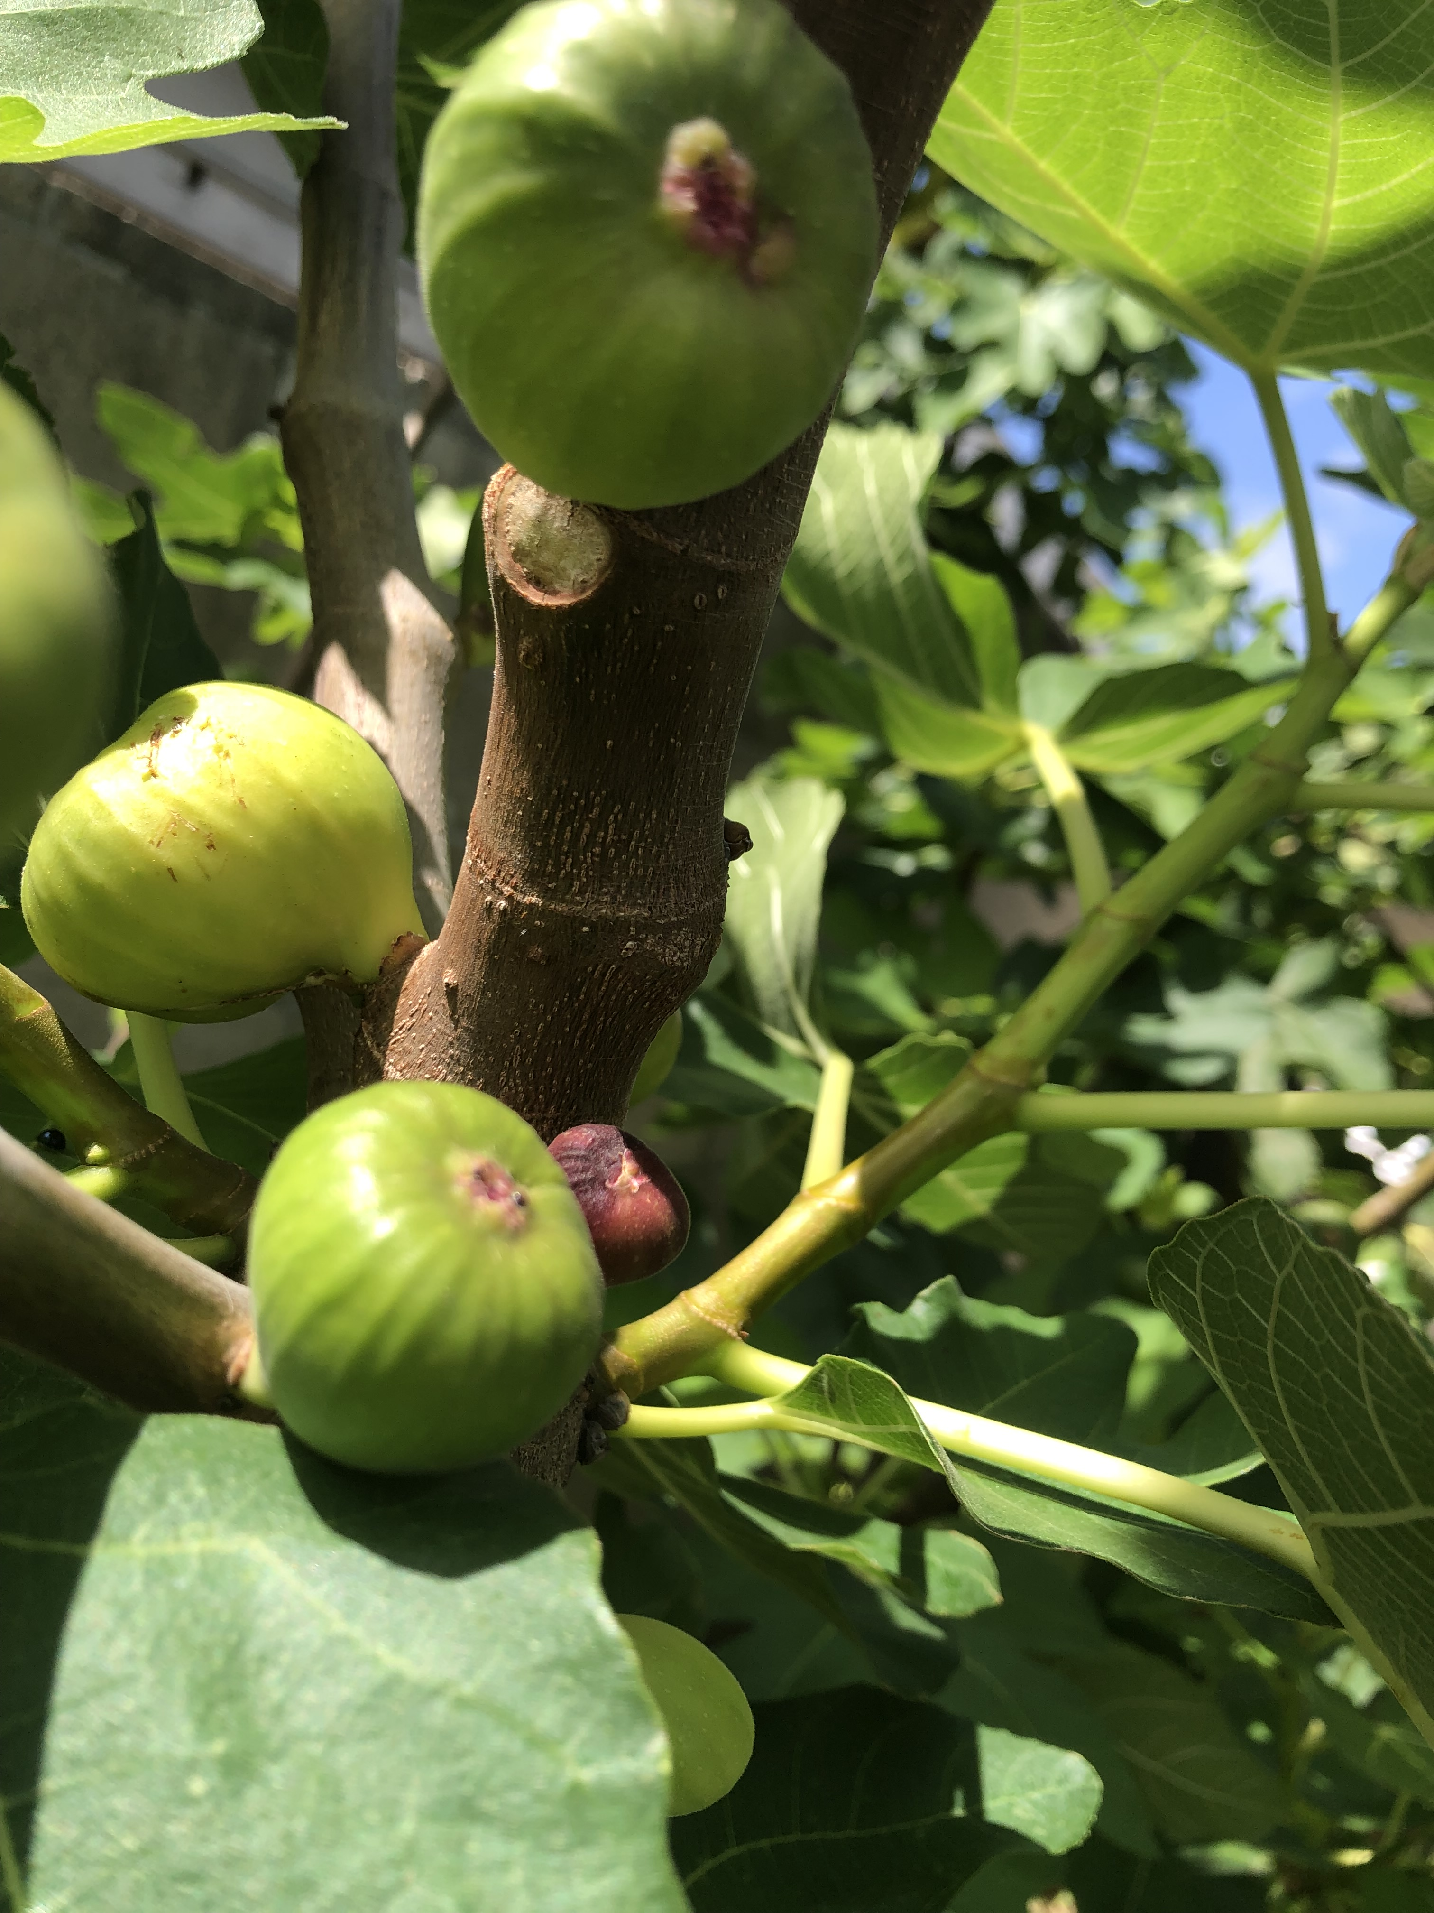
Insights 1/3 From the information provided
Stresses based on place in the life-course:
Young adult aged <26: Clients may enter with feelings of uncertainty, sensitivity, emotional repression, anxiety from internal changes.
Early career or family aged 26-35: Clients may enter with weariness or emotional turbulence from the strains of reproduction or striving for job advancement or troubles with either.
Mid-career/ family aged 36-56: Clients will enter with menopause, mid-life crisis, strain injury, stress over children, parents, juggling careers.
Late career/family aged 50-69: Clients may be experiencing stress over stretched finances, empty nest, fitness decline, parental care or children.
Seniors aged 70 and up: Clients may have stress from stiff muscles, chronic disease, memory loss, change of residence, lost friends & family.
Talk to Me in Flowers

Slide 12
Insights 2/3 From the information provided
1. Sleep challenges like restlessness arise from too much internal heat, insomnia from a mind unable to let go, snoring from retiring after eating.
2. Indigestion indicates emotional stress or dysregulation of the stomach, liver or spleen. Constipation is dehydration, internal heat or low blood.
3. Mild challenges are okay. Easy relationships suggest good social support. A tough week suggests lingering emotion, stress or worry.
4. Strong pulse could indicate high blood pressure or lung strain from internal heat (smoking). Weak pulse indicates low energy and overstrain.
5. The abdomen should be pliable. Stiffness may indicate distension from spleen or stomach overstrain or dysregulation.
6. Dull or pale indicates vitality is low, flushed or dry indicates the body is overtaxed, bright and hydrated indicates vitality is good.
Talk to Me in Flowers

Slide 13
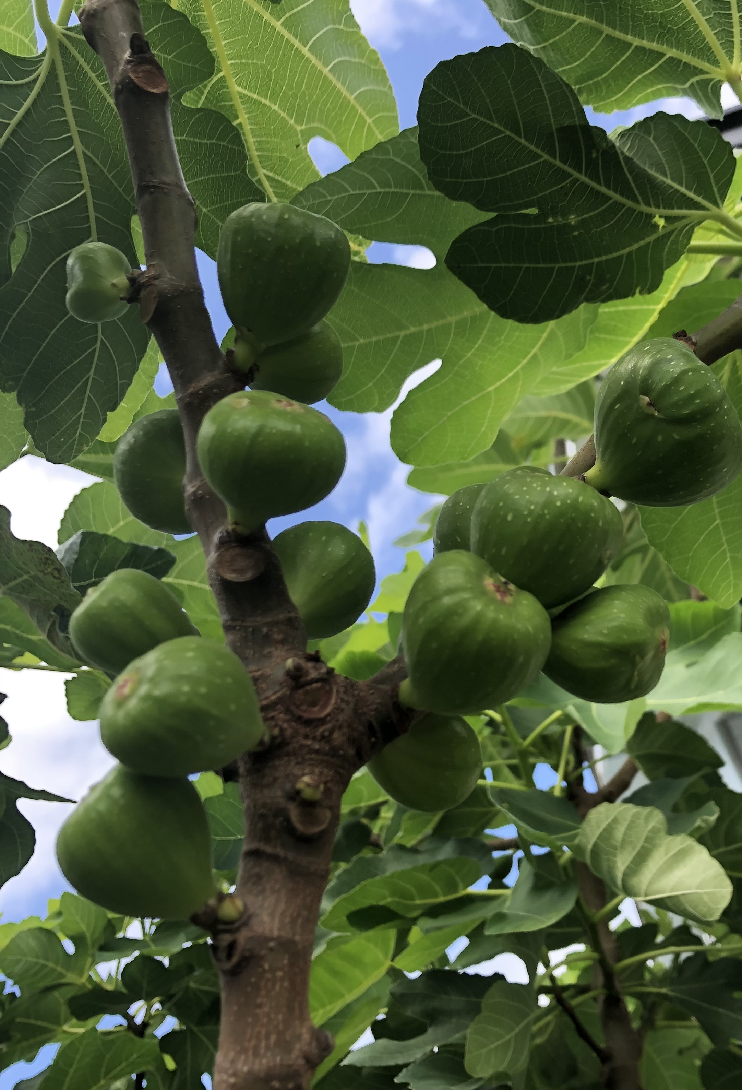
Insights 3/3 From the information provided
7. Hydrated is good. Feeling dry or parched indicates low bodily fluids like blood and lymph from overwork, emotional depletion or aging. Heavy or swollen indicates fluid retention. Feeling cold may indicate that the body’s circulation is dysregulated, while running hot may mean overeating, strong emotions like anger, or burnout. Either can mean the client’s body is not coping with the climate (air conditioning, weather).
8. Experiencing a big transition suggests the body is holding acute stress. The client may be fragile and could become unexpectedly agitated.
9. When negative emotions persist it can obstruct energy flow in the client’s body and cause lingering pressure or even pain in the chest (grief, heartbreak, anxiety: tightness or fullness, shallow breathing, sighing), head (anger, irritability: eye strain, jaw tension, headache) or gut (worry, overthinking, frustration, resentment: bloating, stomach-ache, anxiety).
10. It’s great to be naturally calm when anticipating something good however many people have mixed feelings that can include some anxiety or stress. A stressed client might not achieve results without extra care.
Talk to Me in Flowers

